Slide 1

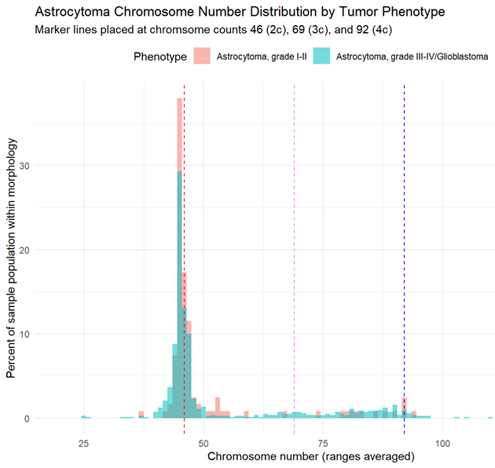
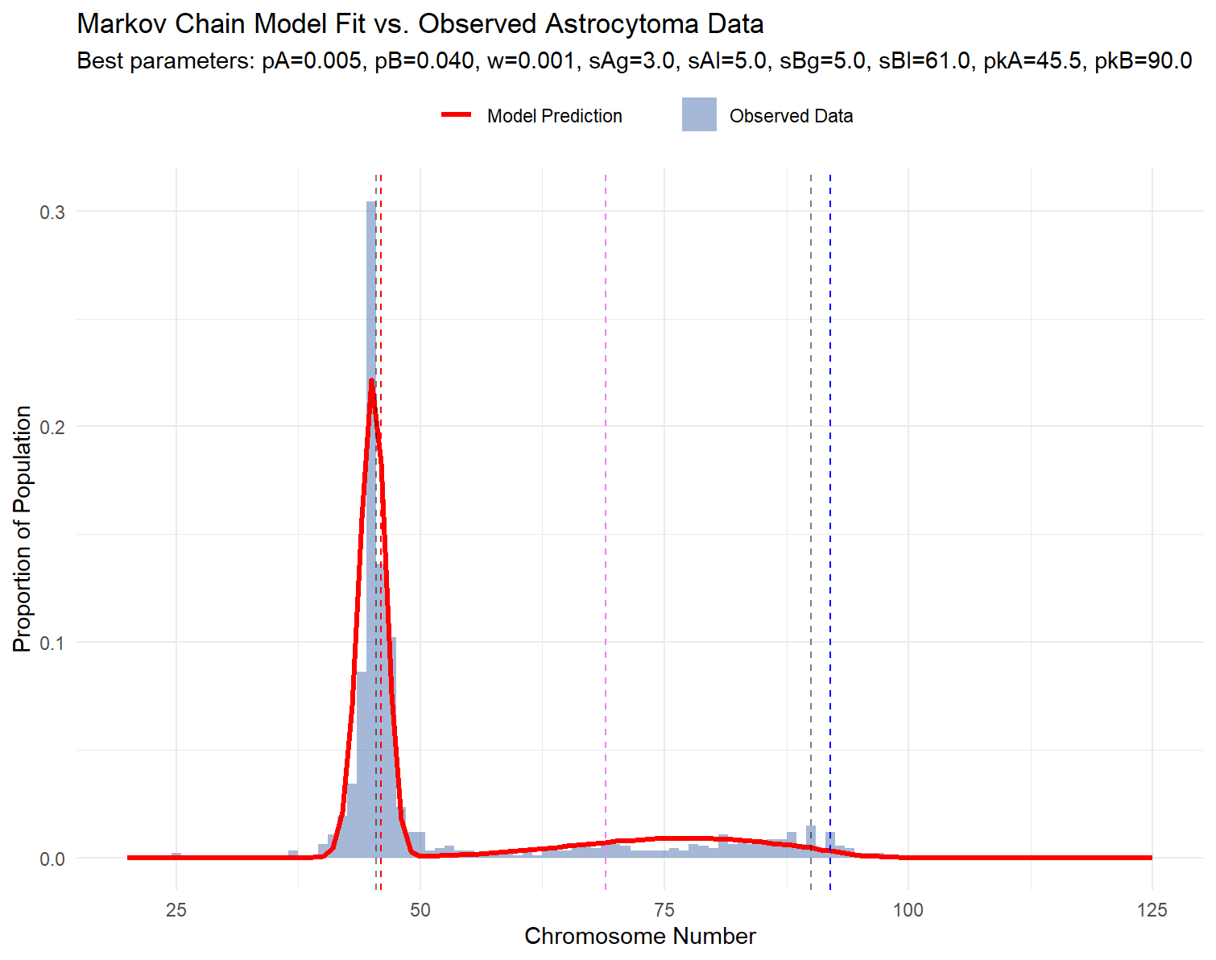
Modeling CIN Cancer Evolution: A Dual Population Approach for Astrocytoma
William Feinman¹, Kelly Brock³, Arijit Chakravarty², Madison Stoddard², Paniz Tayebi¹, Ryan Gregory¹
¹University of Guelph, ²Fractal Therapeutics, ³Notable Contribution
Background
Methods
Chromosome Instability (CIN) in cancer cells leads to abnormal karyotypes, wherein chromosomes are duplicated, lost, fragmented, or blended together.
One trend: Bimodality. The same type of cancer can have very different chromosome counts, having a peak close to standard chromosome content (2c), and a peak at a highly increased counts (3c, 4c, etc.), but fewer intermediate counts between those peaks.
Explanation: Whole Genome Doubling (WGD), where a mitotic mishap makes it double the existing count.
Problem: The high count peak often doesn’t match what we’d expect from WGD, and has a very different shape in count distribution from the 2c peak.
Possible solution: Two cancer populations, using different evolutionary strategies.
To test, we use a Markov Chain, followed by a grid search.
|(x-pkA)|
sAg
A
(2c+1)
Start
(2c)
BB
(4c+1)
|(x-pkB)|
sBg
|(x-pkA)|
sAl
A
(2c+-1)
A
(2c)
BB
(4c)
|(x-pkB)|
sBl
w
BB
(4c-1)
pA
pB
Selection
Selection
Repeat for t=5000
Discussion
Iterate for every value of every variable
Wide distribution after simulated WGD indicates high missegregation rate, differing from original population.
Two strategies: Conserve starting chromosome number with low variance, or pursue new options with high variance.
Further investigation: Pathology link, other cancer types, poly-populations?
Results
References
A’Hern, R. P., Jamal-Hanjani, M., Szász, A. M., Johnston, S. R. D., Reis-Filho, J. S., Roylance, R., & Swanton, C. (2013). Taxane benefit in breast cancer—A role for grade and chromosomal stability. Nature Reviews Clinical Oncology, 10(6), 357–364. https://doi.org/10.1038/nrclinonc.2013.67
Storchova, Z., & Kuffer, C. (2008). The consequences of tetraploidy and aneuploidy. Journal of Cell Science, 121(23), 3859–3866. https://doi.org/10.1242/jcs.039537
Vittoria, M. A., Quinton, R. J., & Ganem, N. J. (2023). Whole-genome doubling in tissues and tumors. Trends in Genetics, 39(12), 954–967. https://doi.org/10.1016/j.tig.2023.08.004
Ghosh, S., Choudhury, D., Ghosh, D., Mondal, M., Singha, D., & Malakar, P. (2024). Characterization of polyploidy in cancer: Current status and future perspectives. International Journal of Biological Macromolecules, 268, 131706. https://doi.org/10.1016/j.ijbiomac.2024.131706
Somarelli, J. A., & Johnson, N. A. (2024). Cancer through the Lens of Evolution and Ecology (1st ed.). CRC Press. https://doi.org/10.1201/9781003307921
Haughey, M. J., Bassolas, A., Sousa, S., Baker, A.-M., Graham, T. A., Nicosia, V., & Huang, W. (2023). First passage time analysis of spatial mutation patterns reveals sub-clonal evolutionary dynamics in colorectal cancer. PLOS Computational Biology, 19(3), e1010952. https://doi.org/10.1371/journal.pcbi.1010952
Wickham H, François R, Henry L, Müller K, Vaughan D (2026). dplyr: A Grammar of Data Manipulation. R package version 1.2.1, https://dplyr.tidyverse.org
Wickham H, Vaughan D, Girlich M (2026). tidyr: Tidy Messy Data. R package version 1.3.2, https://tidyr.tidyverse.org
Wickham H (2025). stringr: Simple, Consistent Wrappers for Common String Operations. R package version 1.6.0, https://stringr.tidyverse.org
Wickham H (2016). ggplot2: Elegant Graphics for Data Analysis. Springer-Verlag New York. ISBN 978-3-319-24277-4. https://ggplot2.tidyverse.org
Øksendal, B. K. (2005). Stochastic differential equations: An introduction with applications (6th ed., corrected third printing 2005). Springer.
Dekking, M., Kraaikamp, C., Lopuhaä, H. P., & Meester, L. E. (Eds.). (2005). A Modern Introduction to Probability and Statistics: Understanding Why and How. Springer London. https://doi.org/10.1007/1-84628-168-7
Mitelman Database of Chromosome Aberrations and Gene Fusions in Cancer (2026). Mitelman F, Johansson B, Mertens F and Paulsson K (Eds.), https://mitelmandatabase.isb-cgc.org
Wang, J., & LaFramboise, T. (2019). CytoConverter: A web-based tool to convert karyotypes to genomic coordinates. BMC Bioinformatics, 20(1), 467. https://doi.org/10.1186/s12859-019-3062-4
Krupina, K., Goginashvili, A., & Cleveland, D. W. (2024). Scrambling the genome in cancer: Causes and consequences of complex chromosome rearrangements. Nature Reviews Genetics, 25(3), 196–210. https://doi.org/10.1038/s41576-023-00663-0
Cross, W. C. H., Nowinski, S., Cresswell, G. D., Mossner, M., Banerjee, A., Lu, B., Williams, M. J., Vlachogiannis, G., Gay, L. J., Baker, A.-M., Kimberley, C., Whiting, F. J. H., Belnoue-Davis, H. L., Martinez, P., Traki, M., Walther, V., Smith, K., Fernandez-Mateos, J., Yara-Romero, E., … Graham, T. A. (2026). Negative Selection Maintains Grossly Altered but Broadly Stable Karyotypes in Metastatic Colorectal Cancer. Cancer Discovery, 16(2), 218–234. https://doi.org/10.1158/2159-8290.CD-24-0813
Gerges, N., Fontebasso, A. M., Albrecht, S., Faury, D., & Jabado, N. (2013). Pediatric high-grade astrocytomas: A distinct neuro-oncological paradigm. Genome Medicine, 5(7), 66. https://doi.org/10.1186/gm470

